Slide 1
PIN Configuration:
0 - UART0 Debug TX
1 - UART0 Debug RX
2 - Display SDA
3 - Display SCL
4 - UART1 MIDI TX
5 - UART1 MIDI RX
6 - Encoder 1 A
7 - Encoder 1 B
8 - Encoder 2 A
9 - Encoder 2 B
10 - Encoder 3 A
11 - Encoder 3 B
12 - Encoder 4 A
13 - Encoder 4 B
14 - I2S DOUT
15 - I2S DIN
16 - I2S LRCK
17 - I2S BCLK
18 - Encoder 1 btn
19 - Encoder 2 btn
20 - Encoder 3 btn
21 - Encoder 4 btn
22 - Joystick button
23 - RGB LED
24 - Board button
25 - Board LED
26 - Joystick X
27 - Joystick Y
28 -
29 -
Expand P85 with:
- 4x knobs for CC or settings
- pitch/mod joystick
- led strip on keys
- extra functionality
--- sequencer/drum machine/arpeggiator NEXT
--- midi record/play/??
--- scales, transpose, split
Working as midi device → DAW/PC/Phone
Working as midi host → receive/ctrl USB midi device
Pin usage (27):
- 3 joystick (1x with button)
- 4 microSD
- 2 display
- 1 led strip (or 2)
- 2 midi uart
- 12 rotary (4x with button)
USB
DSP
4x rotary
4x (I2S)
12x
1x joyst
3x
microSD
P85 wrapper
Display
ssd1306
4x (SPI)
2x (I2C)
2x (UART)
Midi i/f
1x
Led strip
P85 🎹

Slide 2
CLASSES
The program executes a loop of:
- call tick on each manager
- - this transfers inputs to the in-queue
- - and outputs from the out-queue
- process messages from the in-queue
- execute scheduled activities
- - e.g. get messages in the out-queue at a given time
Notes:
- there’s just 2 queues, in and out
- the poly msg base overloads new and takes a param to know in which queue it sits
- the leds are updated via PIO and DMA, continuously iterating over an array. Led updates done on the array are reflected on the strip as soon as the DMA gets there
- the msg processor acts sequentially on msgs in the in-queue. Checks the message against a set of rules. Each rule has a set of match conditions to see if it fires or not. If it fires, it executes something with the message
- each match is just an operator with some parameters, the execution is a sequence of operator and parameters. Actually this should become some kind of asm, and same for the execution phase
SD Card manager
Encoders manager
Message queue
Scheduler
Joystick manager
Polymorphic Msg base
Leds manager
Synth manager
Display manager
Msg processor
MIDI UART manager
Match processor
MIDI USB manager
Action processor
Notes:
S

Slide 3
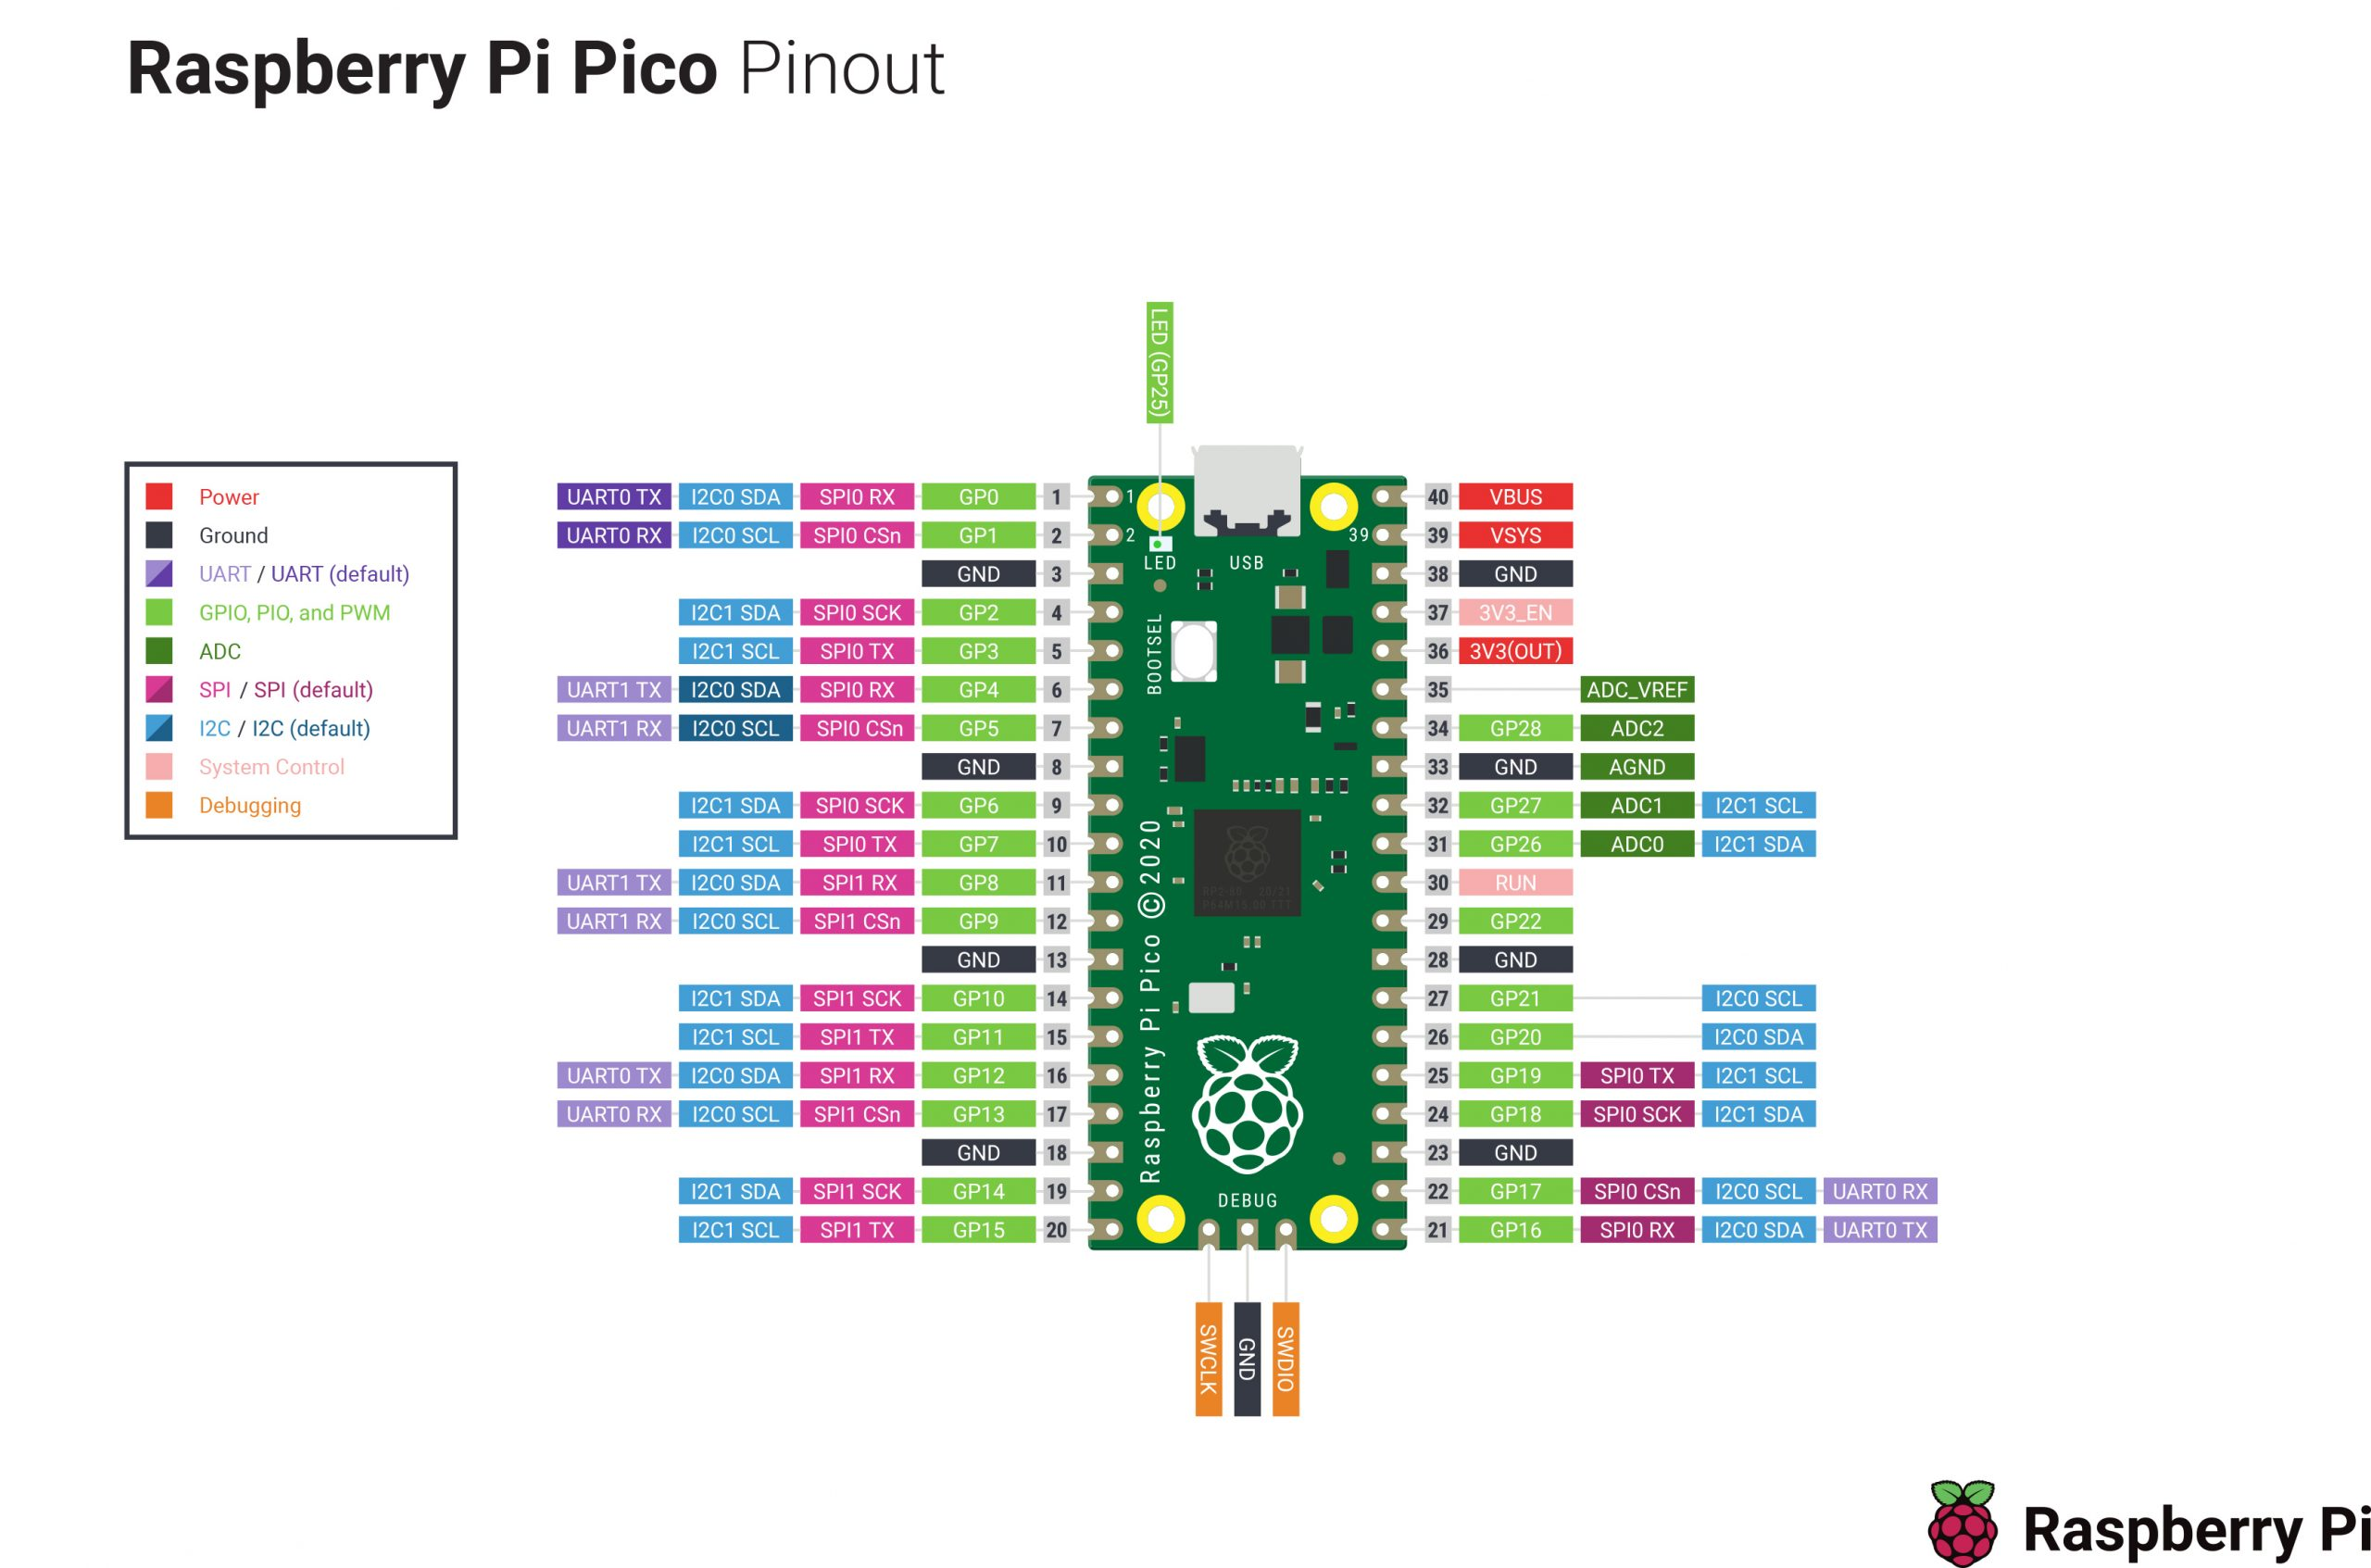

Slide 4
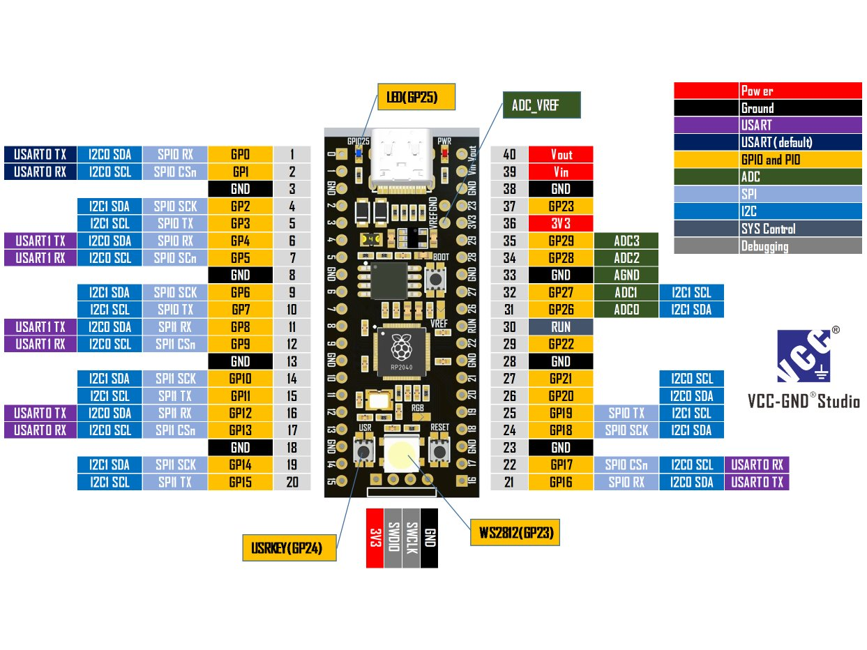

Slide 5
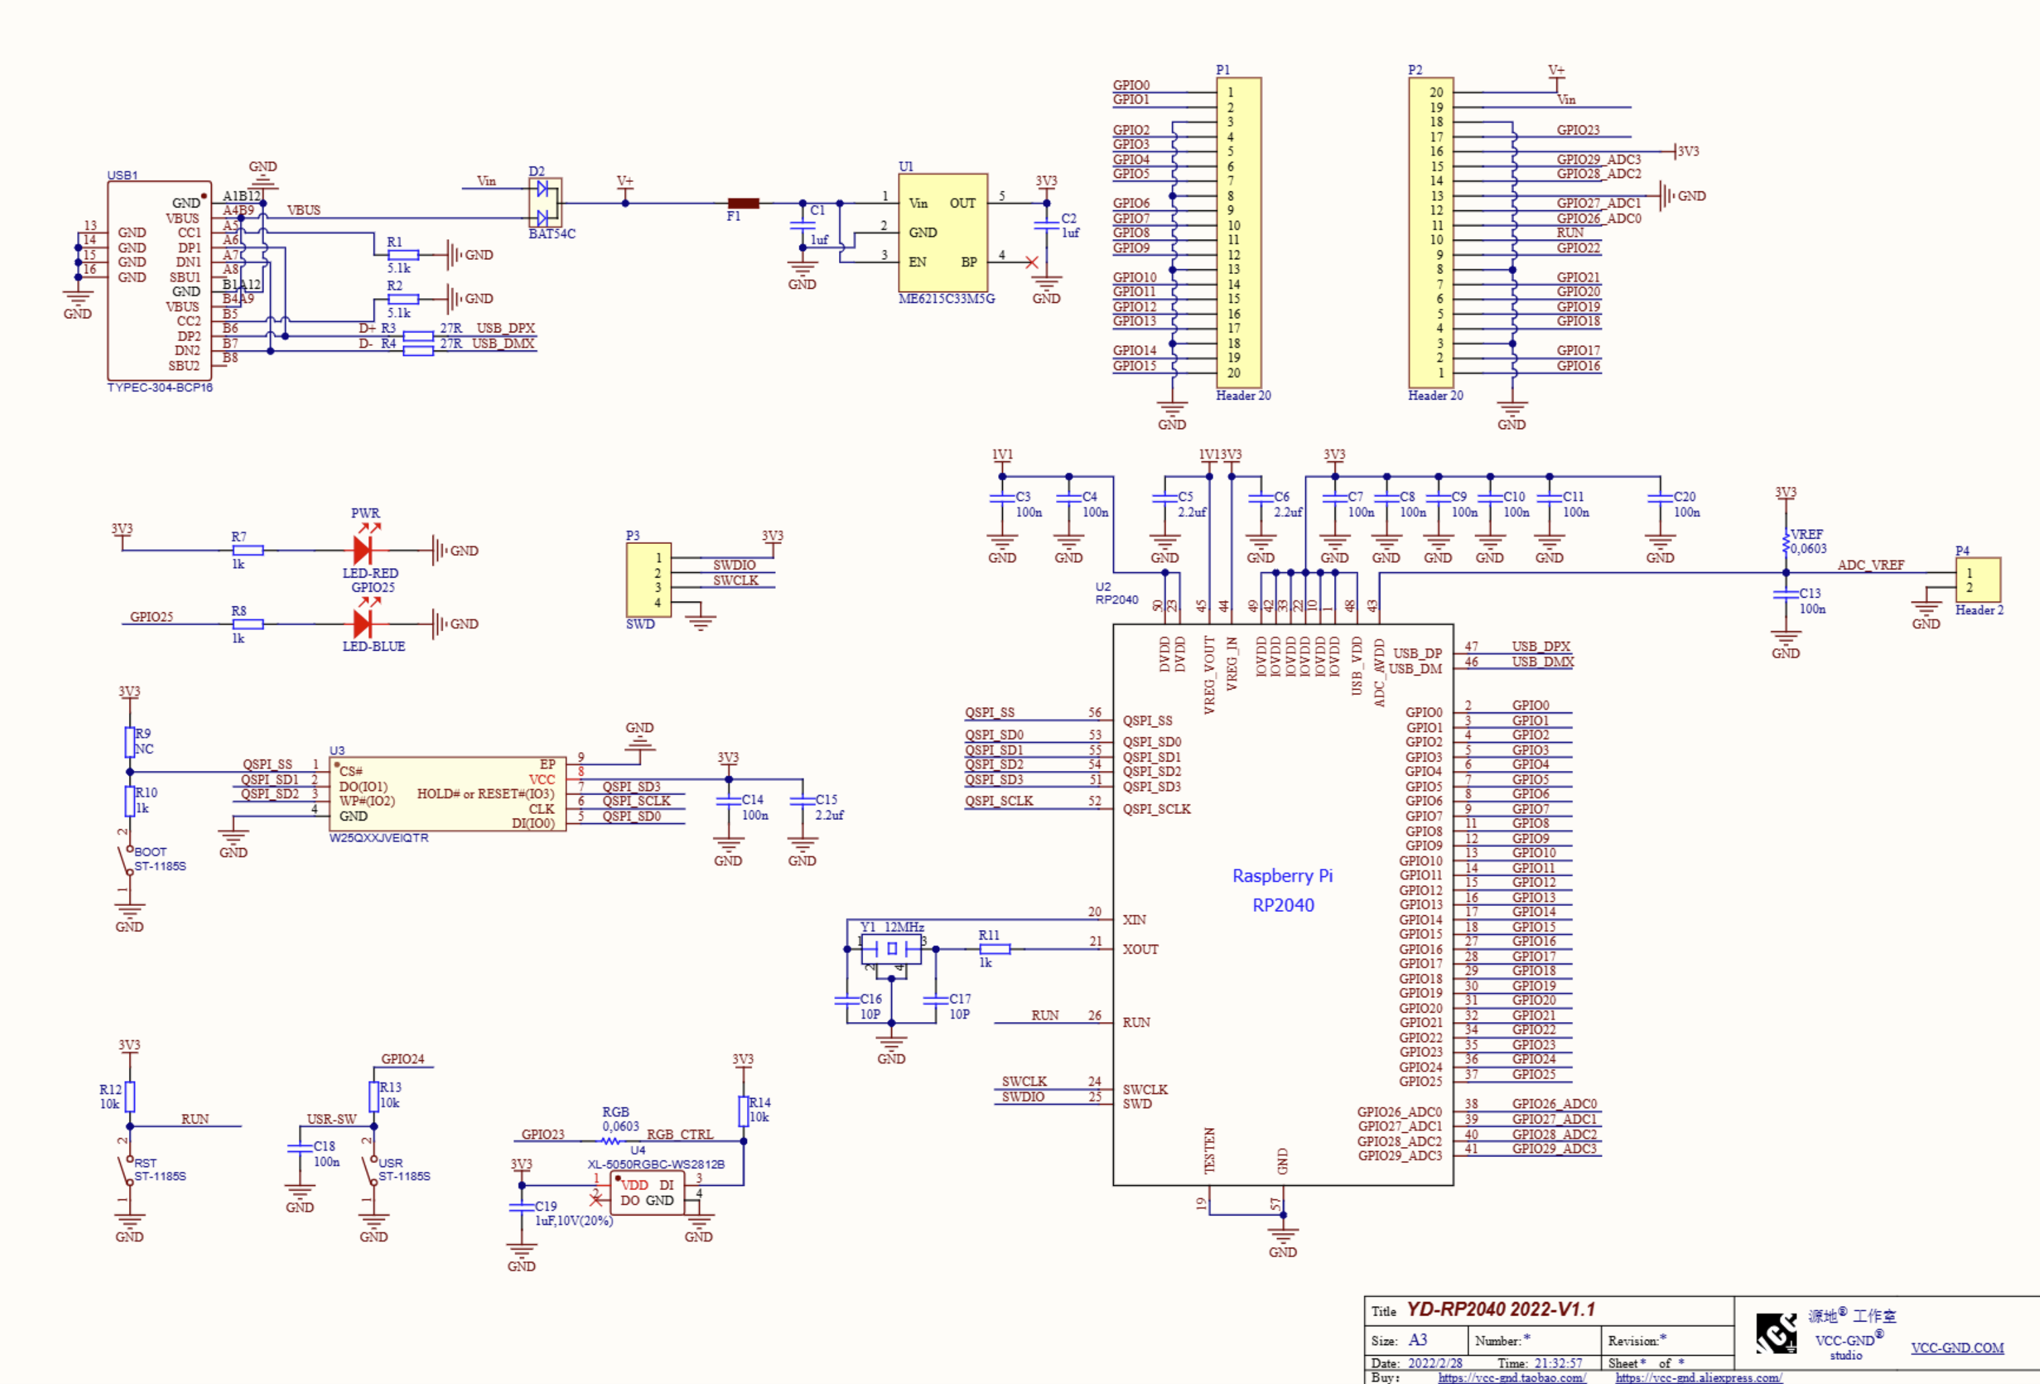

Slide 6
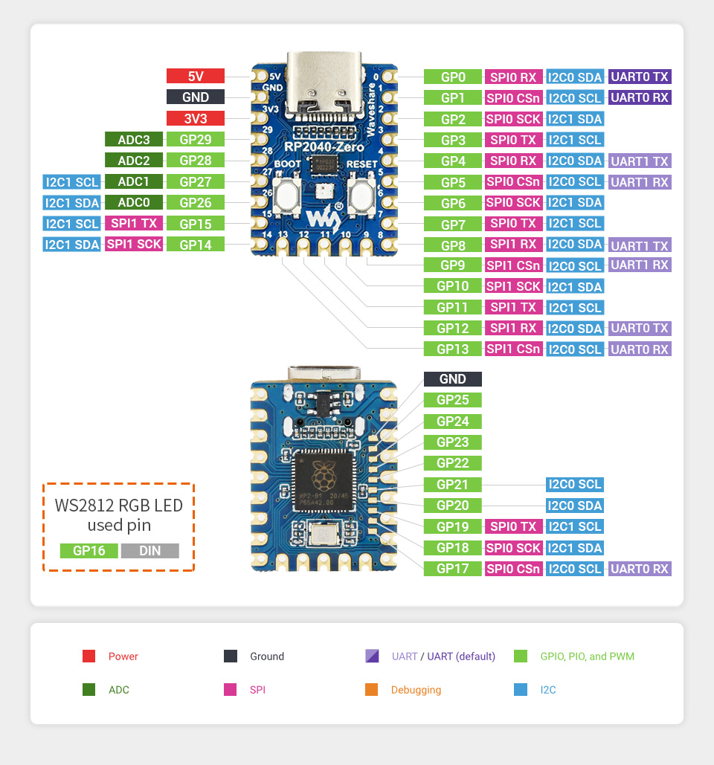

Slide 7
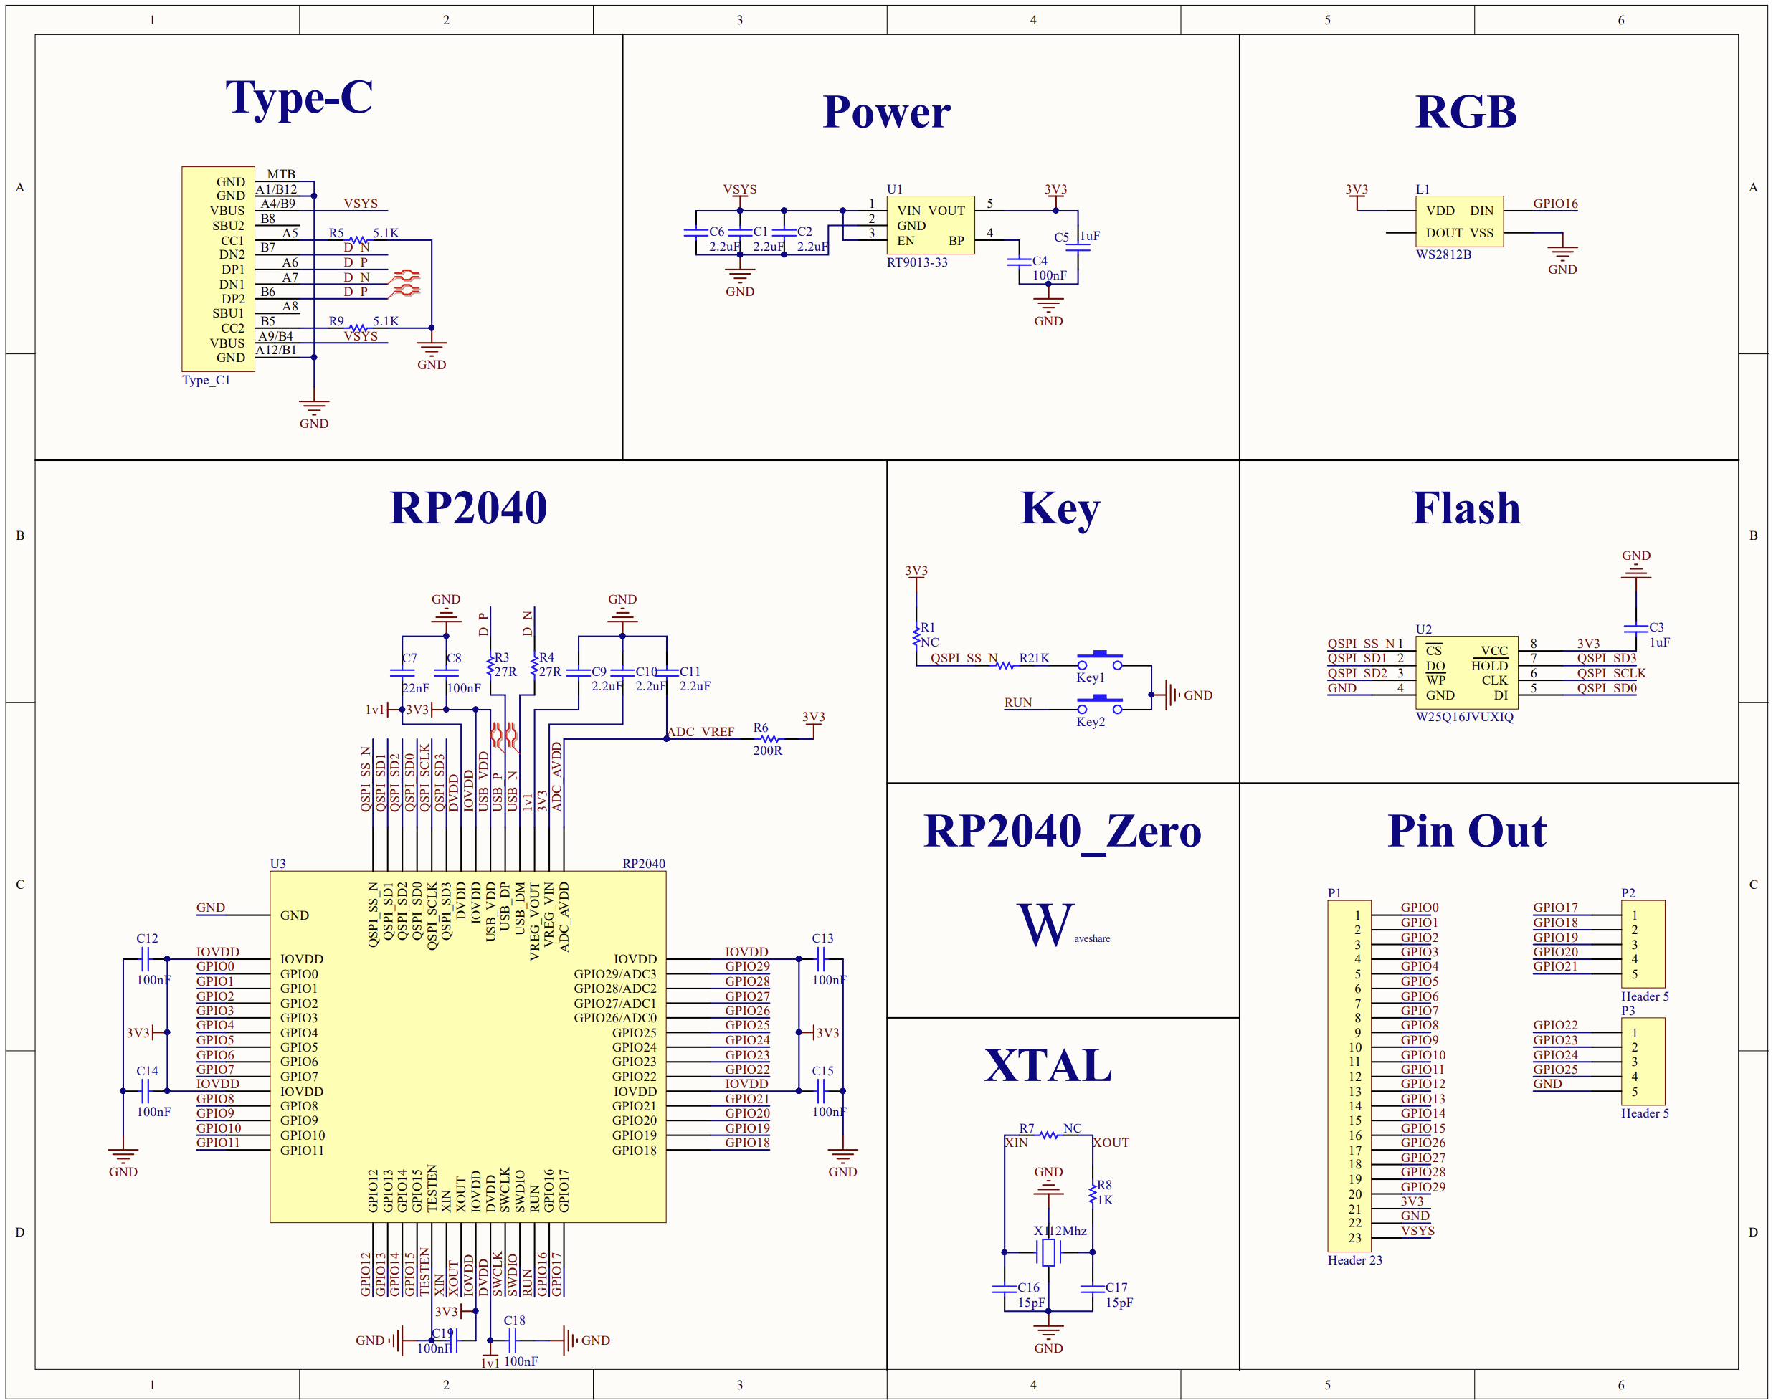

Slide 8
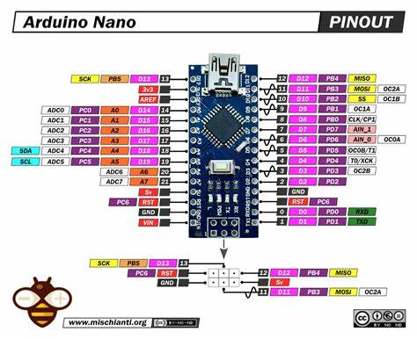

Slide 9
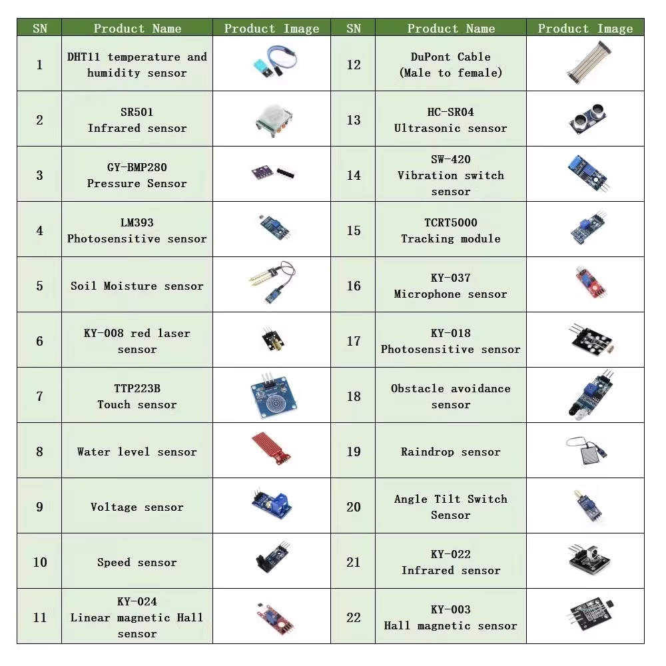

Slide 10
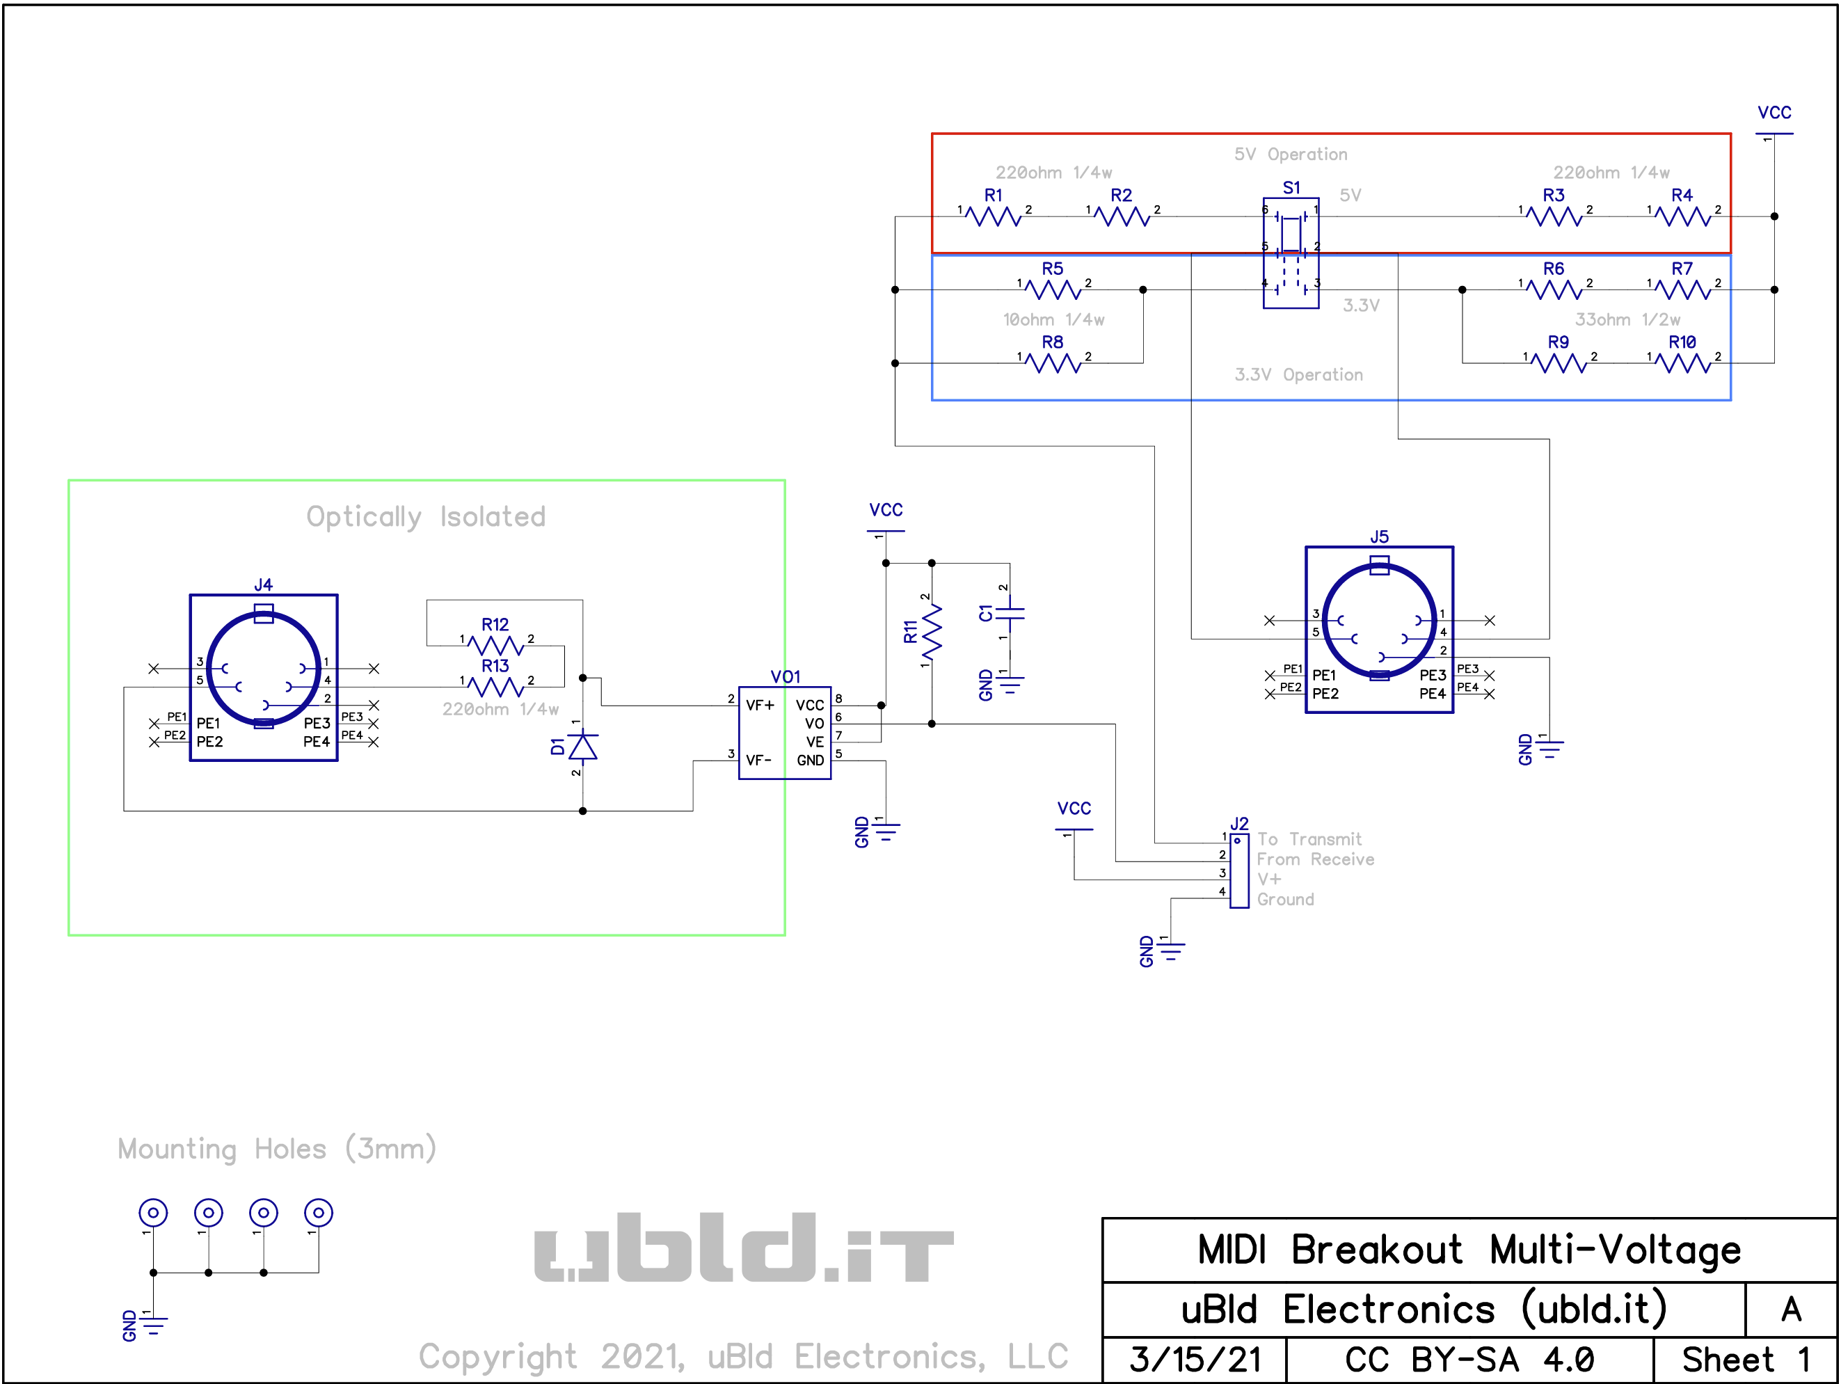
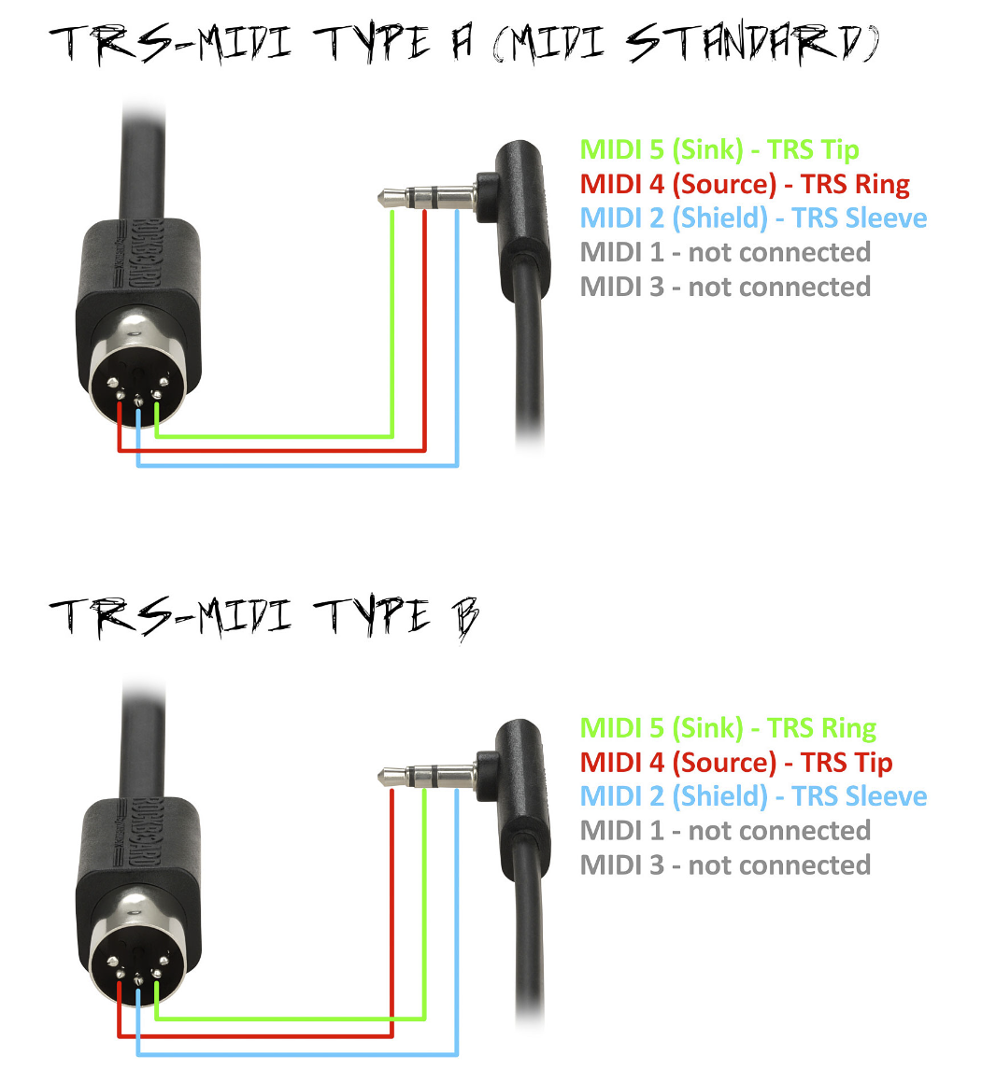
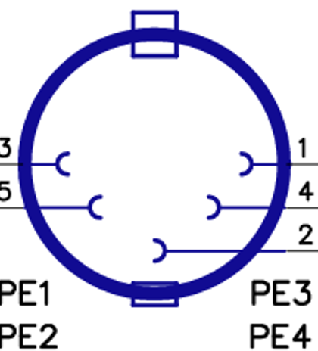
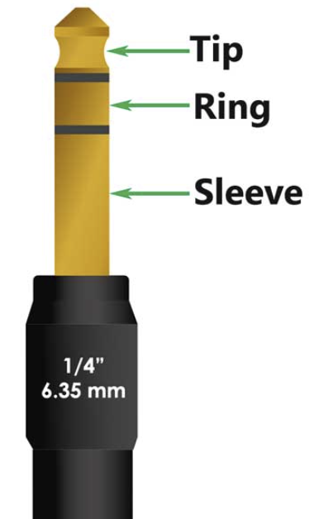

Slide 11
🎤💻
Delay = 4x Buffer size
I2S - USB
Input Buffer B
Input Buffer A
Input Buffer B
Input Buffer A
Input Buffer A
Input Buffer B
Input Buffer A
Input Buffer B
Input Buffer A
DeMux
Work Buffers
Work Buffers
Work Buffers
Work Buffers
Work Buffers
Work Buffers
Work Buffers
Work Buffers
Work Buffers
DSP
Work Buffers
Work Buffers
Work Buffers
Work Buffers
Work Buffers
Work Buffers
Work Buffers
Work Buffers
Work Buffers
Mux
Output Buffer B
Output Buffer A
Output Buffer B
Output Buffer A
Output Buffer A
Output Buffer B
Output Buffer A
Output Buffer B
Output Buffer A
I2S - USB
🎤💻

Slide 12
Analog
I2S Input Buffer
Digital
USB Input Buffer
DSP working area
DSP operations:
A - combine buffers
-- params:
input buffer numbers, offset, length, scaling factors,
output buffer number, offset
B – Convolution
-- params:
input buffer number, offset, length, kernel values
output buffer number, offset
C - Compressor
D - Overdrive
USB Output Buffer
I2S Output Buffer

Slide 13
I2S Input Buffer
USB Input Buffer
SD Input Buffer
DSP working area
DSP operations:
A - combine buffers
-- params:
input buffer numbers, offset, length, scaling factors,
output buffer number, offset
B – Convolution
-- params:
input buffer number, offset, length, kernel values
output buffer number, offset
C - Compressor
D - Overdrive
E – Wave generator
SD Output Buffer
USB Output Buffer
I2S Output Buffer

Slide 14
Stereo jack 1
Stereo jack 2
Stereo jack 3
Stereo jack 4
DSP Loop 1
USB
Total
16 channel IN
- 8 analog, 8 digital
16 channel OUT
- 8 analog, 8 digital
Pin usage:
- 16 I2S data
- 2 I2S sync
Selectable mode: Master/Slave
Stereo jack 9
Stereo jack 10
IN-01
IN-02
IN-03
IN-04
IN-05
IN-06
IN-07
IN-08
IN-09
IN-10
OUT-01
OUT-02
OUT-03
OUT-04
ADC 1
DSP
DAC 1
I2S - 1
I2S - 9
I2S - 2
I2S - 10
I2S - 15
I2S - 16
DAC 2
ADC 2
I2S - 3
I2S - 11
PIO1
- I2S ➔ Input buffers, alternating
- Output buffers, alternating ➔ I2S
Core 1
- DSP over working buffers
Core 2
- DeMux Input buffers ➔ Working input, last slot
- Mux Working output, first slot ➔ Output buffers
- USB input buffers ➔ Working USB input buffers
- Working output buffers ➔ USB output buffers
I2S - 4
I2S - 12
I2S - 5
OUT-05
OUT-06
OUT-07
OUT-08
IN-11
IN-12
IN-13
IN-14
IN-15
IN-16
IN-17
IN-18
IN-19
IN-20
I2S - 6
Stereo jack 11
Stereo jack 12
Stereo jack 5
Stereo jack 6
Stereo jack 7
Stereo jack 8
DSP Loop 2
I2S - 7
I2S - 13
I2S - 8
I2S - 14

Slide 15
Stereo jack 1
USB
Input blocks
Stereo jack 2
GND | GND
WCK | WCK
SCK | SCK
I2S 1 | I2S 5
I2S 2 | I2S 6
I2S 3 | I2S 7
I2S 4 | I2S 8
SCK | SCK
WCK | WCK
GND | GND
Stereo jack 3
Stereo jack 4
DSP
Stereo jack 5
Stereo jack 6
Stereo jack 7
Stereo jack 8
Output blocks
Stereo jack 9
GND | GND
WCK | WCK
SCK | SCK
I2S 9 | I2S 13
I2S 10 | I2S 14
I2S 11 | I2S 15
I2S 12 | I2S 16
SCK | SCK
WCK | WCK
GND | GND
Stereo jack 10
Stereo jack 11
Stereo jack 12

Slide 16
Stereo jack 1
Stereo jack 2
Stereo jack 3
Stereo jack 4
DSP Loop 1
Total
12 channel IN
- 8 analog, 4 digital
8 channel OUT
- 8 analog
Pin usage (22):
- 8 I2S data
- 2 I2S sync
- 4 microSD
- 6 Screen
- 2 MIDI
USB
Stereo jack 9
Stereo jack 10
IN-01
IN-02
IN-03
IN-04
IN-05
IN-06
IN-07
IN-08
IN-09
IN-10
OUT-01
OUT-02
OUT-03
OUT-04
ADC 1
DSP
DAC 1
I2S - 1
I2S - 5
🎤
I2S - 2
I2S - 6
I2S mic 1
I2S mic 2
DAC 2
🎤
ADC 2
I2S - 3
I2S - 7
PIO1
- I2S ➔ Input buffers, alternating
- Output buffers, alternating ➔ I2S
Core 1
- DSP over working buffers
- Manage MIDI
Core 2
- DeMux Input buffers ➔ Working input, last slot
- Mux Working output, first slot ➔ Output buffers
- USB input buffers ➔ Working USB input buffers
- Working output buffers ➔ USB output buffers
- Manage Screen I/O
I2S - 4
I2S - 8
SPI+I2C (x6)
OUT-05
OUT-06
OUT-07
OUT-08
SPI (x4)
UART (x2)
IN-11
IN-12
IN-13
IN-14
IN-15
IN-16
IN-17
IN-18
IN-19
IN-20
Stereo jack 11
Stereo jack 12
Stereo jack 5
Stereo jack 6
Stereo jack 7
Stereo jack 8
DSP Loop 2
microSD
MIDI
Screen

Slide 17
Stereo jack 1
Stereo jack 2
Stereo jack 3
Stereo jack 4
Digital IN 1
Digital mixer:
- many inputs, mux/demux in USB and all outputs
- super low latency
- basic signal processing -- optional
Total
12 channel IN
- 8 analog, 4 digital
8 channel OUT
- 8 analog
Pin usage (18):
- 8 I2S data
- 2 I2S sync
- 4 microSD
- Control i2c 2
- adc/dac/ i2c 2
USB
Stereo jack 9
Stereo jack 10
IN-01
IN-02
IN-03
IN-04
IN-05
IN-06
IN-07
IN-08
IN-09
IN-10
OUT-01
OUT-02
OUT-03
OUT-04
ADC 1
DSP
DAC 1
I2S - 1
I2S - 5
I2S - 2
I2S - 6
I2S in 1,2
I2S in 3,4
DAC 2
ADC 2
I2S - 3
I2S - 7
I2S - 4
I2S - 8
I2C (x2)
OUT-05
OUT-06
OUT-07
OUT-08
SPI (x4)
I2C (x2)
PIO1
- I2S ➔ Input buffers, alternating
- Output buffers, alternating ➔ I2S
Core 1
- DSP over working buffers
- Manage MIDI
Core 2
- DeMux Input buffers ➔ Working input, last slot
- Mux Working output, first slot ➔ Output buffers
- USB input buffers ➔ Working USB input buffers
- Working output buffers ➔ USB output buffers
- Manage ADC/DAC/Screen I2C I/O
- Manage I2C Control interrupts
IN-11
IN-12
IN-13
IN-14
IN-15
IN-16
IN-17
IN-18
IN-19
IN-20
Stereo jack 11
Stereo jack 12
Stereo jack 5
Stereo jack 6
Stereo jack 7
Stereo jack 8
Digital IN 2
microSD
Control
Display

Slide 18
Main concept:
- receive midi from inputs
- - knobs and rotary act as limited midi inputs
- transform them, eventually configuring a seq
- send midi to outputs (straight or from seq)
- - led strip acts as an output
- show what’s going on in the oled
- save everything that’s happening as mid on sd
- load configuration and other stuff from sd
- interact with user with CLI over usb-d-serial
- - usb-h is done via pio
Modes of operation
1 - routing matrix
2 - p85 wrap based on pdf manual
3 – sequencer (arpeggios and drum patterns)
USB-D in
oled
USB-D out
USB-H in
USB-H out
Midi in
Midi out
miniMIDI
4x rotary
Led strip
1x joyst
microSD

Slide 19
Expand P85 with:
- 4x knobs for CC or settings
- pitch/mod joystick
- led strip on keys
- extra functionality
--- sequencer/drum machine/arpeggiator NEXT
--- midi record/play/??
--- scales, transpose, split
Working as midi device → DAW/PC/Phone
Working as midi host → receive/ctrl USB midi device
LED Strip appears as a midi channel
PIN Count:
- pico2 (22)
--- 12 rotary (PIO 1)
--- 6 joysticks
--- 2 midi uart
--- 2 collab uart
- Pico1 (21)
--- 12 rotary (PIO 1)
--- 2 display and more (I2C)
--- 2 collab uart
--- 4 microsd spi
--- 1 rgb led (PIO 2)
USB device
Led strip
4x rotary
1x (PIO)
0x (USB)
12x (PIO)
microSD
Pico 1
display
4x (SPI)
2x (I2C)
2x (UART)
USB host
0x (USB)
Pico 2
4x rotary
12x (PIO)
6x
2x (UART)
Midi i/f
2x joyst
P85 🎹

Slide 20
Expand P85 with:
- 4x knobs for CC or settings
- pitch/mod joystick
- led strip on keys
- extra functionality
--- sequencer/drum machine/arpeggiator NEXT
--- midi record/play/??
--- scales, transpose, split
Working as midi device → DAW/PC/Phone
Working as midi host → receive/ctrl USB midi device
LED Strip appears as a midi channel
PIN Count:
- Pico1 (25)
--- 2 display and more (I2C)
--- 2 collab uart
--- 6 joystick
--- 4 microsd spi
--- 1 rgb led (PIO 2)
--- 10 audio 8+8 channel I2S (PIO 1)
- pico2 (28)
--- 24 rotary (PIO 1)
--- 2 midi uart
--- 2 collab uart
USB device
Led strip
2x joyst
1x (PIO)
0x (USB)
6x
microSD
Pico 1
display
4x (SPI)
2x (I2C)
2x (UART)
10x (I2S)
ADCDAC
2x (UART)
USB host
0x (USB)
Pico 2
24x (PIO)
8x rotary
2x (UART)
Midi I/O jacks
P85 🎹

Slide 21
Power
ADC, DAC, 12 Jacks
Midi I/O jacks
Pico 1
Pico 2
RJ45
RJ45
2x joystick
JTAG
ribbon
ribbon
8x rotary
display
Mic
microSD
Mic
JTAG
Led strip (29+23+23+23+23+25+23)

Slide 22
12v in
Expand P85 with:
- 4x knobs for CC or settings
- pitch/mod joystick
- led strip on keys
- extra functionality
--- sequencer/drum machine/arpeggiator NEXT
--- midi record/play/??
--- scales, transpose, split
Working as midi device → DAW/PC/Phone
Working as midi host → receive/ctrl USB midi device
LED Strip appears as a midi channel
PIN Count:
- Pico1 (25)
--- 2 display and more (I2C)
--- 2 collab uart
--- 6 joystick
--- 4 microsd spi
--- 1 rgb led (PIO 2)
--- 10 audio 8+8 channel I2S (PIO 1)
- pico2 (28)
--- 24 rotary (PIO 1)
--- 2 midi uart
--- 2 collab uart
→ 4 pin I2S
→ 4 pin I2S
5v out
3.3v in
→ 3.5mm
→ 3.5mm
PCM1864
→ 3.5mm
→ 3.5mm
→ 4 pin I2S
→ 4 pin I2S
→ 3.5mm
→ 3.5mm
PCM1864
→ 3.5mm
→ 3.5mm
← 3.5mm
Pico 1
← 3.5mm
PCM1960
← 3.5mm
10x (I2S)
ADCDAC
← 3.5mm

Slide 23
TLV320AIC33IRGZR
→ 3.5mm
→ 3.5mm
TLV320AIC33IRGZR
→ 3.5mm
→ 3.5mm
TLV320AIC33IRGZR
→ 3.5mm
→ 3.5mm
TLV320AIC33IRGZR
→ 3.5mm
→ 3.5mm

Slide 24
Expand P85 with:
- 4x knobs for CC or settings
- pitch/mod joystick
- led strip on keys
- extra functionality
--- sequencer/drum machine/arpeggiator NEXT
--- midi record/play/??
--- scales, transpose, split
Working as midi device → DAW/PC/Phone
Working as midi host → receive/ctrl USB midi device
LED Strip appears as a midi channel
PIN Count:
- Pico1 (19)
--- 2 display and more (I2C)
--- 2 collab uart
--- 6 joystick
--- 4 microsd spi
--- 1 rgb led (PIO 2)
--- 4 audio 8+8 channel I2S (PIO 1)
- pico2 (28)
--- 24 rotary (PIO 1)
--- 2 midi uart
--- 2 collab uart
USB device
Led strip
2x joyst
1x (PIO)
0x (USB)
6x
microSD
Pico 1
display
4x (SPI)
2x (I2C)
2x (UART)
4x (I2S)
ADCDAC
4x TLV320AI33
2x (UART)
USB host
0x (USB)
Pico 2
24x (PIO)
8x rotary
2x (UART)
Midi I/O jacks
P85 🎹

